Slide 1

Rice University Water and Energy Research Center
Qilin Li
Department of Civil and Environmental Engineering
Rice University
April 15, 2014
Notes:
Mark Twain use to say that
“Whiskey is for Drinking, water is for fighting over”
We hope it will never get to that when it comes to energy production,
But, water is one of the biggest bones of contention as well as one of the fastest growing limiting factor for the development of oil and gas reserves, as recognized by a recent SPE publication about the Grand Challenges Facing E&P Industry

Slide 2

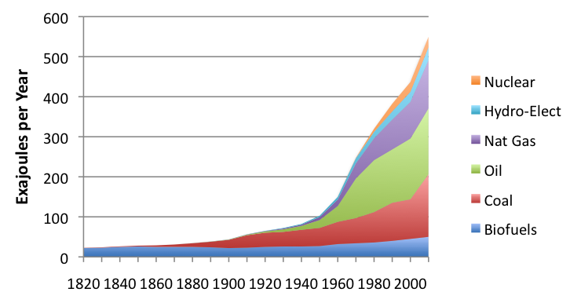
World Energy Consumption
http://ourfiniteworld.com/2012/03/12/
Notes:
The world is hungry for energy, The chart shows the rapid increase in energy consumption since the 1950s and indicates continuation of that trend. 1 exajoules is 10E18 joules.

Slide 3
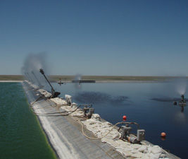

Importance of Water for Energy
Residual Additives
Heavy Metals
Scaling ions
Organics
Salts
Water is the largest byproduct of the fossil fuel industry
Unconventional O&G and biofuel production requires large quantities of water
Water/Oil Ratio = 10 (US), 14 (Can.) $1 trillion/yr challenge*
50 gallons of water per mile driven on ethanol
*http://www.twdb.state.tx.us/Desalination/TheFutureofDesalinationinTexas-Volume2/documents/B3.pdf
Notes:
Unfortunately, energy and water and intricately connected.
For example, About $1 trillion (of $6T total expenses) are spent on maintaining production, and much of that cost relates to water. I don’t mean just the handling treatment and disposal of the large amounts of flowback water but also water-related impairment such as corrosion, biofouling, and reservoir souring.

Slide 4
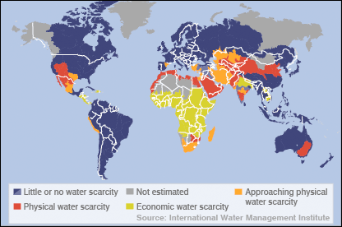
Global Water Crisis
Stressors:
Population growth
Climate change
Contamination
Source: International Water Management Institute, 2006, Comprehensive Assessment of Water Management in Agriculture
Notes:
At the same time, the world is running out of water.
Projected global water scarcity in 2025.
Physical water scarcity: More than 75% of river flows are allocated to agriculture, industries or domestic purposes (accounting for recycling of return flows). This definition of scarcity - relating water availability to water demand - implies that dry areas are not necessarily water-scarce, eg Mauritania.
Approaching physical water scarcity: More than 60% of river flows are allocated. These basins will experience physical water scarcity in the near future.
Economic water scarcity: Water resources are abundant relative to water use, with less than 25% of water from rivers withdrawn for human purposes, but malnutrition exists. These areas could benefit by development of additional blue and green water, but human and financial capacity are limiting.
Little or no water scarcity: Abundant water resources relative to use. Less than 25% of water from rivers is withdrawn for human purposes.

Slide 5
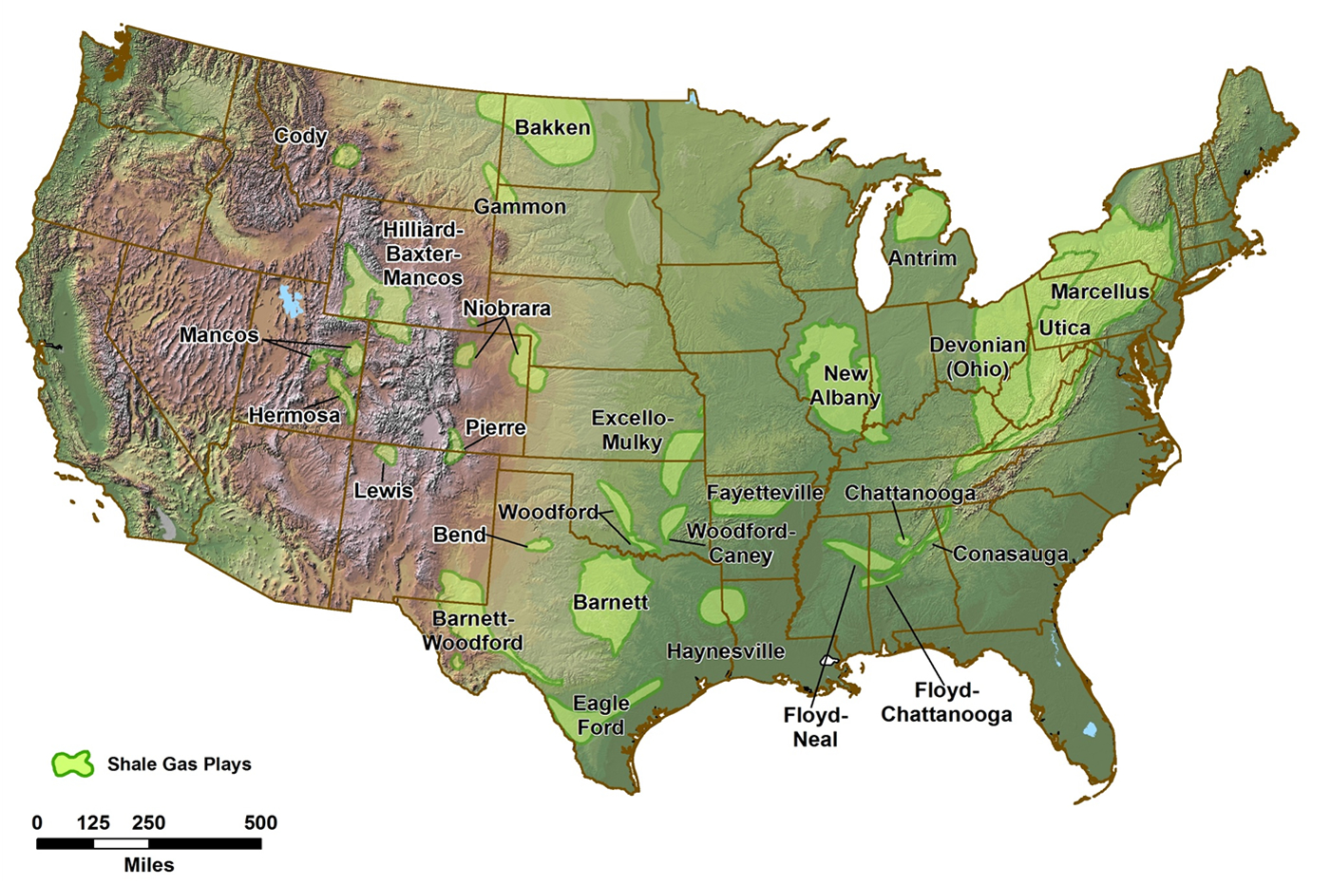
Hydraulic Fracturing Water Use
Bakken₁:
15000 m³/fracture
Niobrara₂:
12500 m³/fracture
Marcellus₂:
22000 m³/fracture
Barnett₂:
18500 m³/fracture
Eagle Ford₂:
22000 m³/fracture
Haynesville₂:
22000 m³/fracture
1: National Energy Technology Laboratory Winter 2011 Newsletter
2: EPA Hydraulic Fracturing Study Technical Workshop #4: Water Resource Management, March 2011
All-llc.com
Notes:
These numbers are from the summation of the water used to drill one well and perform one fracture at each respective site. These figures do not represent water required for production water once the formation has been fractured.
1: http://www.netl.doe.gov/technologies/oil-gas/publications/newsletters/epfocus/EPNews2011Winter.pdf
2: http://www.epa.gov/hfstudy/09_Mantell_-_Reuse_508.pdf

Slide 6

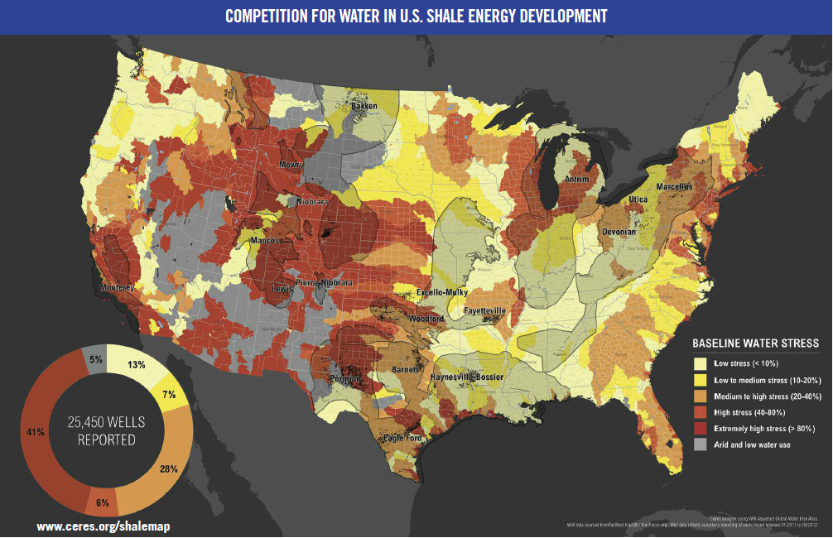
Current Drought Condition in the U.S.
Notes:
“47 percent of wells are found in regions with high or extremely high water risk indicating growing competitive pressure on water supplies for shale energy development.
65.8 billion gallons of water was used for fracking last year, representing the water use of 2.5 million Americans for a year. Nearly half (47 percent) of the wells were developed in water basins with high or extremely high water stress. In Colorado, 92 percent of the wells were in extremely high water stress areas. In Texas, which accounts for nearly half of the total number of wells analyzed, 51 percent of the wells were in high or extremely high water stress areas.” ceres report.

Slide 7
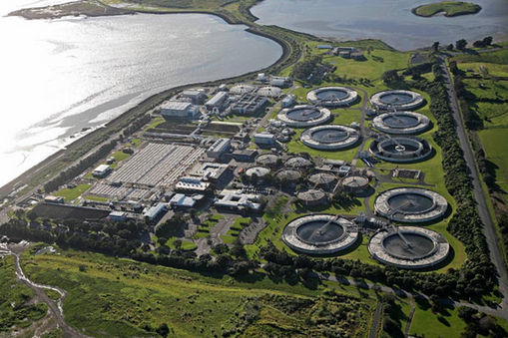
Energy for Water Production
20% of energy use in cities is for moving water¹
Desalination and wastewater reuse is energy intensive ²
1. Electric Power Research Institute, Inc. Water & Sustainability (Volume 4): U.S. Electricity Consumption for Water Supply & Treatment – The Next Half Century. 2002.
2. Water Reuse Association, Seawater desalination cost, January 2012
Notes:
Conversely, energy is needed to treat and move water. About 20% of energy in cities in the USA is used moving water
In Managua, it is 40%
These statistics remind us that the security of water and the security of energy are the two greatest challenges that we face in this 21st century, and they are increasingly interconnected .
We simply cannot treat and distribute water without energy, and we cannot produce energy without water .

Slide 8





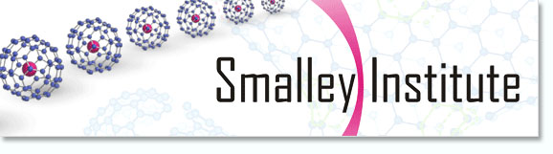

Notes:
And we are in the process of establishing a Water and Energy Center, which is a natural evolution from CBEN which was a first mover in nanonetchnology-enabled water treatment and the fate and transport of nanomaterials in the environment.
This new center also builds on ongoing research efforts that consider separately important parts of the puzzle, such as policy, brine chemistry, EOR and advanced materials.

Slide 9
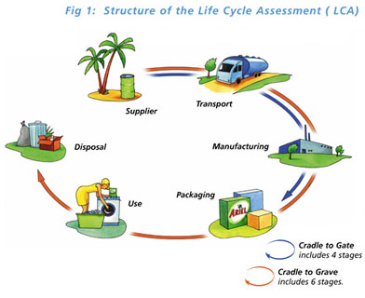
Vision
Policy
Life Cycle
Perspective
Integrated Water Management
Nano
Technology
Bio
Adv. Mat.
Notes:
Overall, we will use a multidisciplinary approach guided by a life cycle systems perspective, and work at the convergence of nanotechnology with biotechnology for technology innovation, as well as collaborate with policy experts to find transformative practical solutions and enable Integrated Water Management to achieve sustainable water management and address challenges of the energy-water nexus.
For the energy industry, this means reduce water reuse and waste discharge and better management of other water related problems; for municipalities, this means modernizing urban water infrastructure to increase treatment capability and efficiency while decreasing energy requirements

Slide 10
Mission
Establish an ecosystem of innovation in partnership with the energy and water industries as well as municipalities to:
  Enhance the sustainable and efficient use (and reuse) of water resources in energy production
  Reduce the economic and environmental costs of the water footprint
  Alleviate water-related impairment (e.g., souring, corrosion, flooding)
  Increase energy efficiency, safety and reliability of urban water supply
Notes:
This center would foster fundamental research that is problem driven and user inspired, to:
Alleviate water-related impairment.
Such as reservoir souring, biofouling and corrosion of critical infrastructure

Slide 11

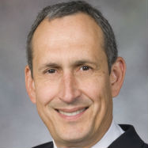






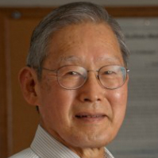



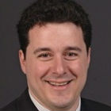
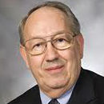


RiceWERC Faculty
Pulickel Ajayan
Nanomaterials for water and energy
Pedro J. Alvarez
Microbial control
bioremediation, WFP
Andrea Ballestero
Water law, economics and techno-science
Phil Bedient
Urban hydrology & flood protection
George Bennett
Microbiology and biotechnology
Leonardo Duenas-Osorio
Complex systems
Vicki Colvin
Nano-bio/environ interactions
Naomi Halas
Nanophotonics for disinfection
George Hirasaki
Interfacial phenomena, enhanced oil recovery
Qilin Li
Advanced water treatment
Jun Lou
Nano fab. for
Energy&environ.
Peter Nordlander
Nano photonics
Mateo Pasquali
Fluid mechanics and nano-structures
Mason Tomson
Brine chemistry,
scale prevention
James Tour
Nano for water treatment
Mike Wong
Catalysts for
water treatment
Notes:
Our team includes top material scientists such as Ajayan, nanotechnologists like Vicki Mateo and Naomi, biotechnologies like George and myself, and environmental engs and scientists like Qilin and Mason
Our team includes people with a long track record of collaboration with the industry as well as new faces that bring new perspectives

Slide 12
Integrated Water Management
Resource recovery
Desalination
Softening
Organic removal
Membrane fouling control
Injection water
Microbial control
Scale inhibition
Feedstock Cooling water
Exploration &
extraction
Transportation and storage
Refining
Treated wastewater
Formation water
Brine Chemistry
Water-mineral interactions
Corrosion control
EOR
Flow Assurance
NP transport
Produced
water
Bioremediation
Catalysis
Polluted water & soil
Refinery wastewater
Beneficial reuse
Disposal
Notes:
This is a simplified diagram of water inputs and outputs through oil and gas production, transportation, and refining.
The goal is to minimize Water Withdrawals, Consumption and Pollution Potential Throughout the Life Cycle, and also to enable recycle and reuse in a manner that does not cause impairment, such as reservoir souring when you re-inject water, or flow reduction by scaling, or corrosion.
We will use a System perspective to Identify and Fulfill Technological Needs to address this goal and enable integrated water management. <click>
These are some topics in which we are conductive innovative research that is both fundamental and user inspired. Let me give you three examples
Furthermore, in addition to the large water requirements to produce energy associated with development of reserves, wastewater is generated at various stages of energy production.
And water reuse is a logical approach to both minimize withdrawals and minimize pollution potential.
This underscores the need for both technology innovation and integrated water management.
Solutions: 1) use alternative water sources, e.g. brackish groundwater, wastewater, seawater. 2) Cost effective flowback and produced water reuse could solve all three problems to a large extent. Reuse for injection or other beneficial reuse purposes.

Slide 13
Key Challenges Best Addressed by Academic-industrial Partnerships
Inefficient development of reserves (e.g., reservoir souring, and low O&G recovery)
Safety and operational issues (H₂S, corrosion, scaling)
Increasing costs of water acquisition, treatment and disposal
Regulatory constraints and uncertainty
Beneficial disposition of produced waters
Public mistrust
Notes:
There are many growing water-related challenges that we perceive the energy industry may face, which require taking a preventive and holistic perspective.
Need some regulatory driven and policy informed science
The complexity and magnitude of these challenges require focused multidisciplinary and synergistic collaboration of the type that you would only get in a center.

Slide 14
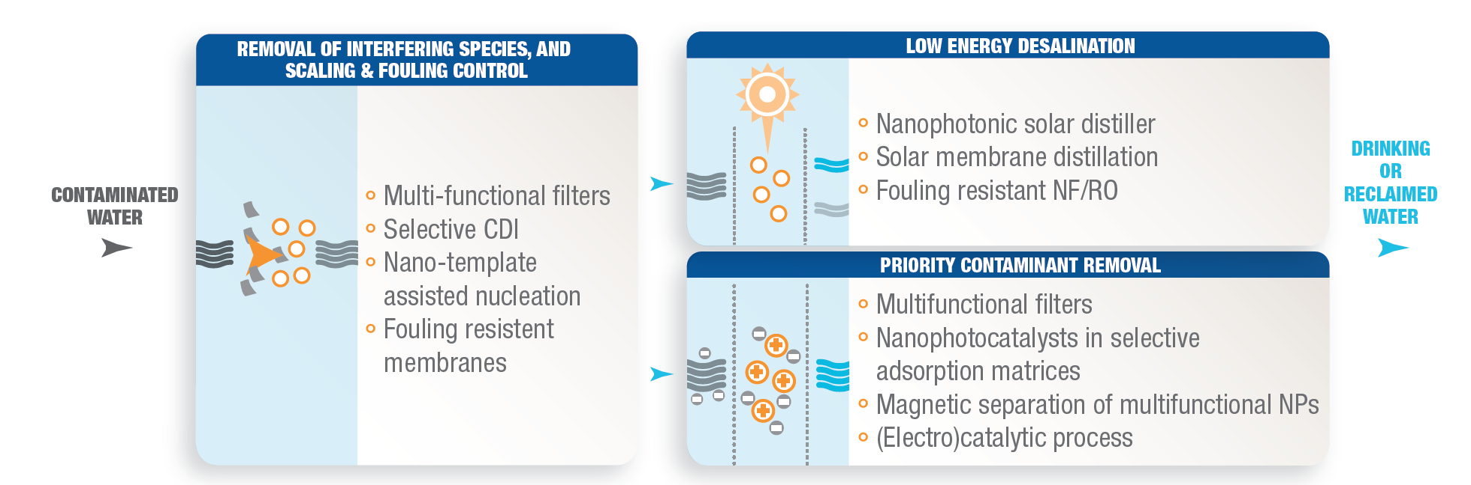
NSF Nanosystems Engineering Research Center for Off-Grid Nanotechnology Enabled Water Treatment (NEWT)
Goal: Mobile, compact, modular, solar powered systems for O&G produced water treatment and drinking water supply
Team: Rice University, Arizona State University, Yale University, University of Texas at El Paso

Slide 15
Invitation to Join WERC and NEWT

